Slide 1
Computer Logic & Design
Lecture 08-09

Slide 2
Type of IC Logic Gates
74XX00 Quad 2-input NAND Gate
74XX02 Quad 2-input NOR Gate
74XX04 Hex Inverter
74XX08 Quad 2-input AND Gate
74XX10 Triple 3-input NAND Gate
74XX11 Triple 3-input AND Gate
74XX20 Dual 4-input NAND Gate
Notes:
To identify and use the Integrated Circuits or ICs in implementing logic circuits, some sort of identification code has to be used which is printed on the IC package.
Thus the various Logic Gates are identified by the codes shown.
The prefix 74 is used to identify a commercial version of the device from the military version device identified by the prefix 54.
Military versions are designed to withstand harsh and severe environmental conditions.
The XX part of the code identifies the switching speed of the gate.

Slide 3
Type of IC Logic Gates
74XX21 Dual 2-input AND Gate
74XX27 Triple 3-input NOR Gate
74XX30 Single 8-input NAND Gate
74XX32 Quad 2-input OR Gate
74XX86 Quad 2-input XOR Gate
74XX133 Single 13-input NAND Gate

Slide 4
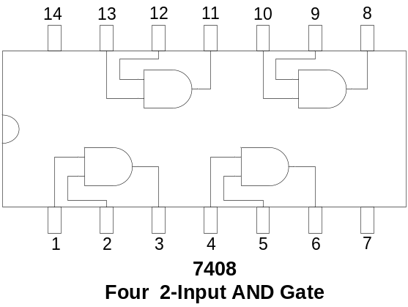
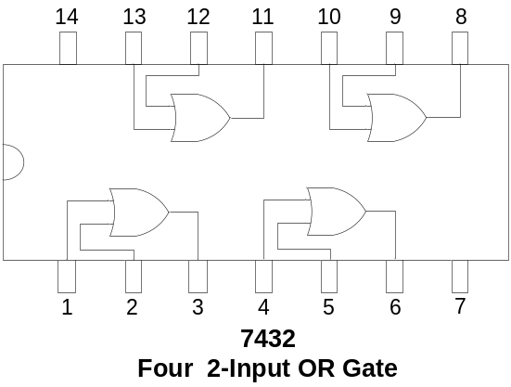
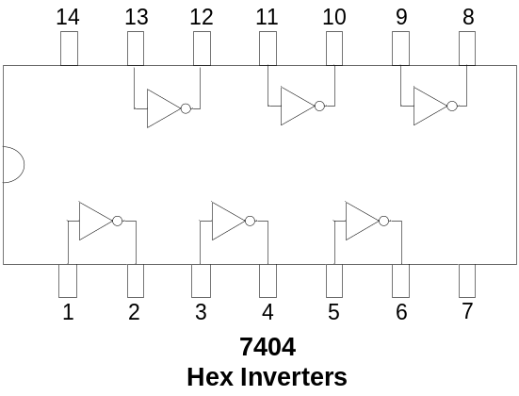
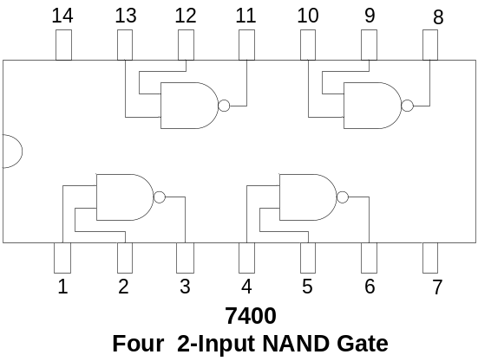
Logic Gate Integrated Circuits
Notes:
The Integrated Circuit packages of the seven gates that have been discussed so far are shown.
The 7408 14-pin chip has 4 or Quad, 2-input AND gates. The input pins and the output pins of each of the four gates are shown. To use any one or all four gates the appropriate pins are connected.
Pins 7 and 14 are connected to ground and Supply voltage respectively.
The 7432 14-pin IC package has 4 or Quad, 2-input OR Gates. Connections to the OR gates are identical to those of the 7408 AND gate IC.
The 7404 14-pin chip has 6 or hex, inverters. The input and output connections of each of the 6 NOT gates are shown. Pins 7 and 14 are used for ground and supply voltage respectively.

Slide 5


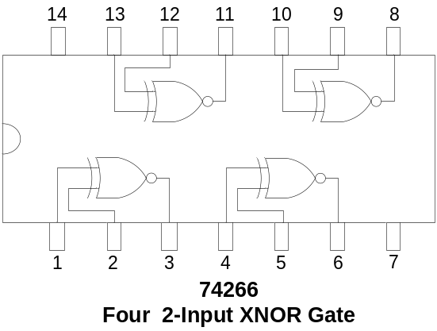
Logic Gate Integrated Circuits
Notes:
The 7400, Quad, 2-input NAND Gate IC
The 7402, Quad, 2-input NOR Gate IC
The 7486, Quad, 2-input XOR Gate IC
And the 74266, Quad, 2-input XNOR Gate IC are similar.

Slide 6
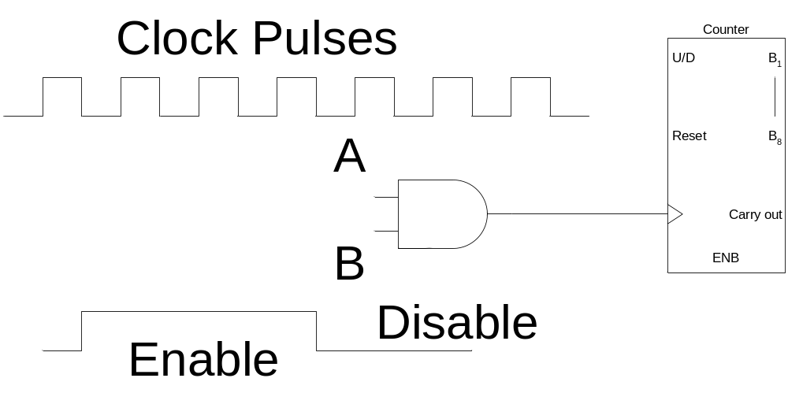
AND Gate Applications
Enable/Disable Device
  Counter counts when it receives pulses

Slide 7
Integrated Circuits (IC)
CMOS Complementary Metal Oxide Logic
TTL Transistor-Transistor Logic
ECL Emitter Coupled Logic
PMOS p-channel MOS transistor
NMOS n-channel MOS transistor
E²CMOS
Notes:
CMOS: The most extensively used technology, characterized by low power consumption, switching speed which is slower but comparable to TTL. Has higher chip density than TTL. Due to high input impedance is easily damaged due to accumulated static charge
TTL: Extensively used technology, characterized by fast switching speed and high power consumption
ECL: Used in specialized applications where switching speed is of prime importance, high speed transmission, memories and arithmetic units
PMOS and NMOS: technologies are used in LSI requiring high chip density. Large memories and microprocessors are implemented using these technologies. These ICs have very low power consumption.
E²CMOS: a combination of CMOS and NMOS technologies used to implement Programmable Logic Devices.

Slide 8
Operational Characteristics
DC Supply Voltage
Noise Margin
Power Dissipation
Frequency Response
Fan Out

Slide 9
TTL Series
74 Standard TTL
74S Schottky TTL
74AS Advanced Schottky TTL
74LS Low-Power Schottky TTL
74ALS Advanced Low-Power Schottky TTL
74F Fast TTL
Notes:
The Standard, the Schottky, the Advanced Schottky, the Low-Power Schottky, the Advanced Low-Power Schottky and the FAST TTL series are characterized by their switching speed and power dissipation. The Standard TTL is the slowest and consumes more power and the Advanced low power Schottky has the fastest switching speed and low power requirements.

Slide 10
CMOS Series
5 V CMOS
  74HC and 74HCT High-Speed
  74AC and 74ACT Advanced CMOS
  74AHC and 74AHCT
  Advanced High Speed
3.3 V CMOS
  74LV Low voltage CMOS
  74LVC Low-voltage CMOS
  74ALVC Advanced Low voltage CMOS
Notes:
There are two separate CMOS series of Integrated Circuits. The 5 volt series and the newer 3.3 volt CMOS series.
The 3.3 v CMOS series is characterized by fast switching speeds and very low power dissipation as compared to the 5 v CMOS series.

Slide 11
Noise Margin
i/p & o/p signals have a range of voltages
Voltage ranges exceeded due to external noise
Effect on performance under noisy conditions
Margin of error

Slide 12
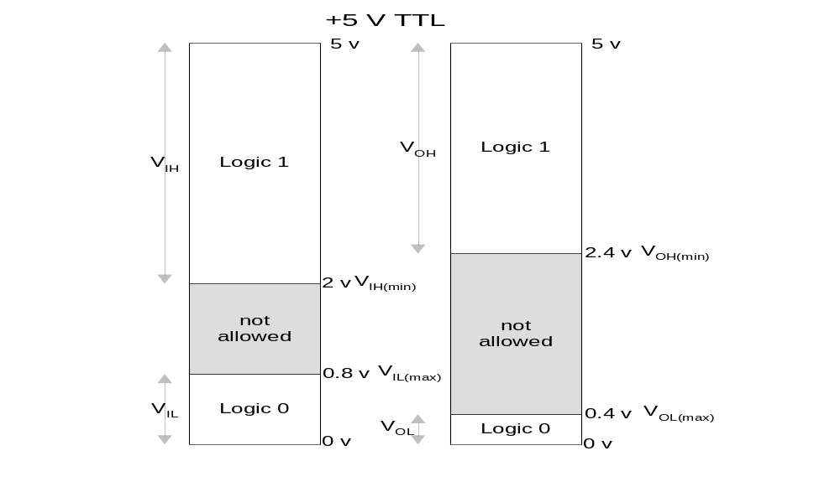
TTL Logic Levels
Notes:
At the input of any TTL logic gate a logic high signal ‘1’ or a logic low signal ‘0’ is applied.
The V_{IH} is the input voltage range of Logic high signal with a range of 2 to 5 volts
V_{IH(min)} is the minimum acceptable input range for a logic high signal
The V_{IL} is the input voltage range of Logic low signal with a range of 0 to 0.8 volts
V_{IL(max)} is the maximum acceptable input range for a logic low signal
Similarly the output of any TTL logic gate can be at logic high ‘1’ or logic low ‘0’
The V_{OH} is the output voltage range of Logic high signal with a range of 2.4 to 5 volts
V_{OH(min)} is the minimum acceptable output range for a logic high signal
The V_{OL} is the output voltage range of Logic low signal with a range of 0 to 0.4 volts
V_{OL(max)} is the maximum acceptable output range for a logic low signal
Consider that the output of an And gate is connected to the input of an OR gate
What are the voltage ranges for the two gates?

Slide 13
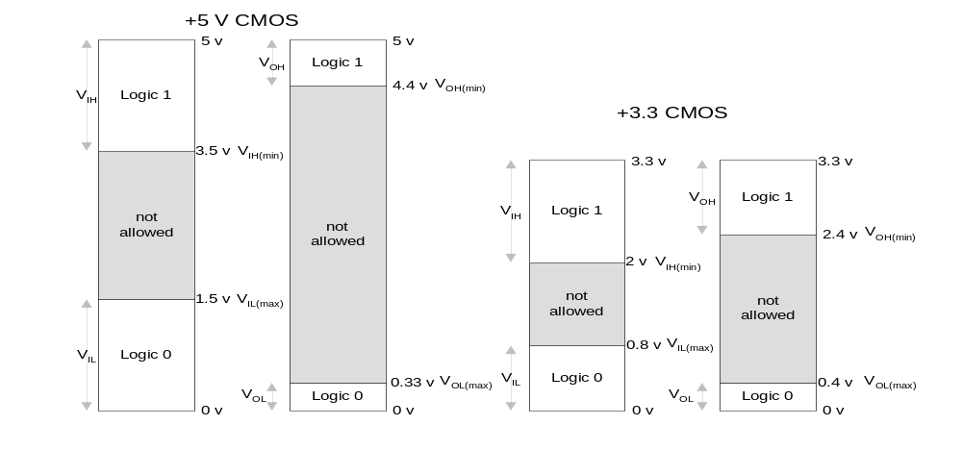
CMOS Logic Levels
Notes:
At the input of any CMOS 5 volt series logic gate a logic high signal ‘1’ or a logic low signal ‘0’ is applied.
The V_{IH} is the input voltage range of Logic high signal with a range of 3.5 to 5 volts
V_{IH(min)} is the minimum acceptable input range for a logic high signal which is 3.5 volts
The V_{IL} is the input voltage range of Logic low signal with a range of 0 to 1.5 volts
V_{IL(max)} is the maximum acceptable input range for a logic low signal which is 1.5 volts
Similarly the output of any CMOS 5 volt series logic gate can be at logic high ‘1’ or logic low ‘0’
The V_{OH} is the output voltage range of Logic high signal with a range of 4.4 to 5 volts
V_{OH(min)} is the minimum acceptable output range for a logic high signal which is 4.4 volts
The V_{OL} is the output voltage range of Logic low signal with a range of 0 to 0.33 volts
V_{OL(max)} is the maximum acceptable output range for a logic low signal which is 0.33 volts
At the input of any CMOS 3.3 volt series logic gate a logic high signal ‘1’ or a logic low signal ‘0’ is applied.
The V_{IH} is the input voltage range of Logic high signal with a range of 2 to 3.3 volts
V_{IH(min)} is the minimum acceptable input range for a logic high signal which is 2 volts
The V_{IL} is the input voltage range of Logic low signal with a range of 0 to 0.8 volts
V_{IL(max)} is the maximum acceptable input range for a logic low signal which is 0.8 volts
Similarly the output of any CMOS 3.3 volt series logic gate can be at logic high ‘1’ or logic low ‘0’
The V_{OH} is the output voltage range of Logic high signal with a range of 2.4 to 3.3 volts
V_{OH(min)} is the minimum acceptable output range for a logic high signal which is 2,4 volts
The V_{OL} is the output voltage range of Logic low signal with a range of 0 to 0.4 volts
V_{OL(max)} is the maximum acceptable output range for a logic low signal which is o.4 volts
The two CMOS 5 volts and the 3.3 volts series can not be mixed.

Slide 14
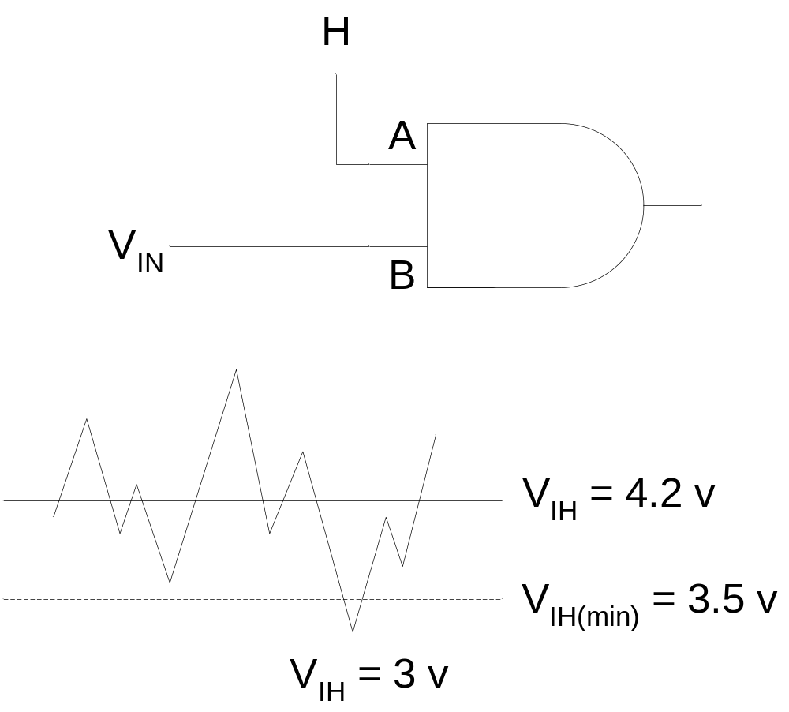
Unpredictable Behaviour due to Noise
Notes:
Consider the CMOS 5 volt series AND gate
Input A of the AND gate is permanently connected to logic high of +5 volts.
Input B of the AND gate is connected to the output of some other gate.
The signal at input B of the AND gate can vary between logic 0 and logic 1.
Consider that the input B is at logic high state with V_{IH} = 4.2 volts which is within the valid voltage range of V_{IH} between 5 and 3.5 volts
Consider a voltage generated due to some external noise added to the 4.2 volt signal.
A sharp dip in the input voltage due to the noise brings the input voltage down to 3 volts for a very short duration.
The 3 volt input is below the minimum input voltage limit of 3.5 volts for logic high input voltage.
This dip in the voltage even for a short duration will result in an output of logic low for a short interval of time, which will cause the logic circuit to malfunction.

Slide 15
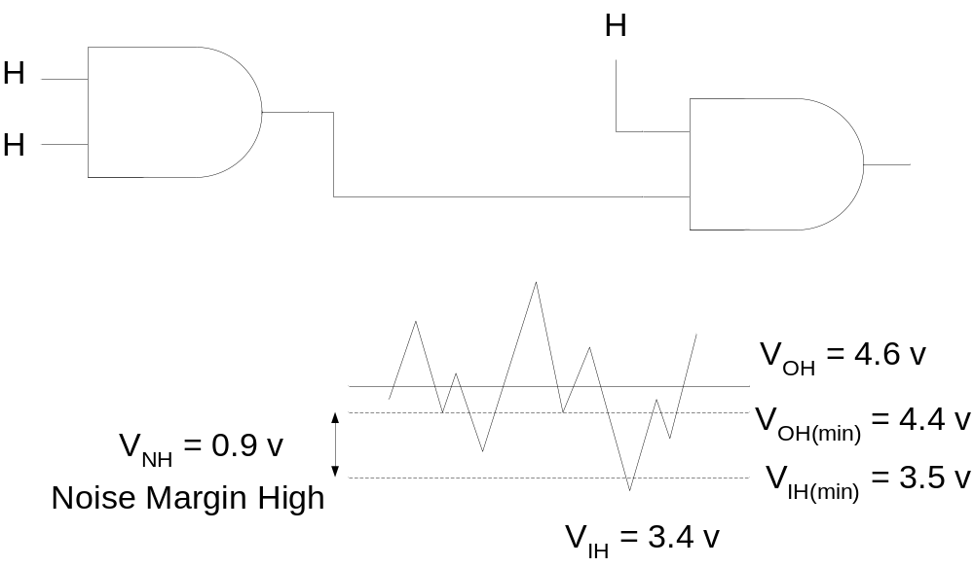
Logic Levels and Noise Margin
V_{NH} = V_{OH(min)} – V_{IH(min)}
V_{NL} = V_{IL(max)} – V_{OL(max)}
Notes:
Consider two CMOS 5 volt series AND gates connected together.
The first AND gate has both its inputs connected to logic high, therefore the output of the gate is guaranteed to be logic high.
The logic high voltage output of the first AND gate is assumed to be at 4.6 volts well within the valid V_{OH} range of 5-4.4 volts.
Assume the same noise signal (as described earlier) being added to the output signal of the first AND gate.
The sharp dip due to noise brings the V_{OH} voltage down to 3.4 volts with reference to the V_{OH} of 4.6 volts.
3.4 volts is lower than the V_{IH(min)} of 3.5 volts required by the input of the second AND gate. Thus the circuit will malfunction.
Since V_{OH(min)} is guaranteed to be at 4.4 volts therefore a noise signal being added to 4.4 volts can bring V_{OH} voltage down to a minimum of 3.5 volts which is the acceptable minimum range for V_{IH}
Anything below 3.5 will cause the second gate to malfunction.

Slide 16
Logic Levels and Noise Margin
CMOS Noise Margins
  V_{NH} = V_{OH(min)} – V_{IH(min)} = 4.4 - 3.5 = 0.9 v
  V_{NL} = V_{IL(max)} – V_{OL(max)} = 1.5 – 0.33 = 1.17 v
  V_{NH} = V_{OH(min)} – V_{IH(min)} = 2.4 – 2.0 = 0.4 v
  V_{NL} = V_{IL(max)} – V_{OL(max)} = 0.8 – 0.4 = 0.4 v
TTL Noise Margins
  V_{NH} = V_{OH(min)} – V_{IH(min)} = 2.4 - 2.0 = 0.4 v
  V_{NL} = V_{IL(max)} – V_{OL(max)} = 0.8 – 0.4 = 0.4 v

Slide 17
Power Dissipation
Power Dissipation constant for TTL
Power Dissipation varies with frequency for CMOS

Slide 18
TTL Power Dissipation
Gate Output High (I_{CCH})
Gate Output Low (I_{CCL})
Average Power Dissipated
P_{cc} = V_{cc} I_{cc}
P_{cc} = V_{cc} (I_{CCH} + I_{CCL})/2

Slide 19
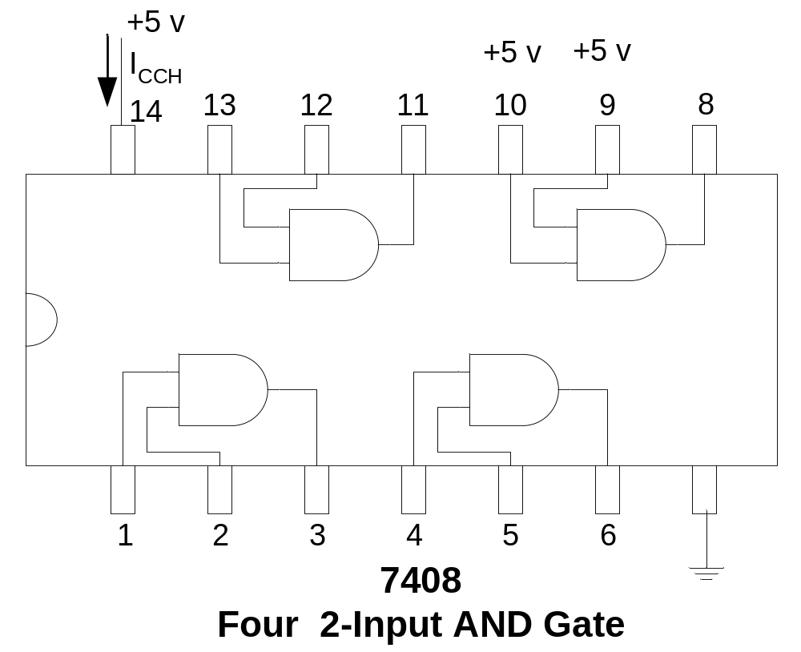
TTL Power Dissipation

Slide 20
CMOS Power Dissipation
Power Dissipation varies with frequency for CMOS
P_{D} = (C_{PD}+ C_{L}).V_{DD}².f
C_{PD} is the internal power dissipation capacitance
C_{L} is the external load dissipation capacitance
V_{DD} is the supply voltage
f is the transition frequency of the output signal
Notes:
The power dissipation of a HCMOS gate is 2.75 μW under static conditions and 170 μW at 100 KHz.

Slide 21
Propagation Delay and Frequency Response
Propagation Delay
Limits frequencies at which gate can operate
Notes:
The Propagation Delay of a gate limits the frequencies at which the gate can work. Larger the Propagation Delay lower is the frequency at which the gate can operate. Smaller the Propagation Delay higher the frequency at which the gate can operate.
A Gate with a delay of 3 nsec is faster than a gate with a 10 nsec delay.

Slide 22
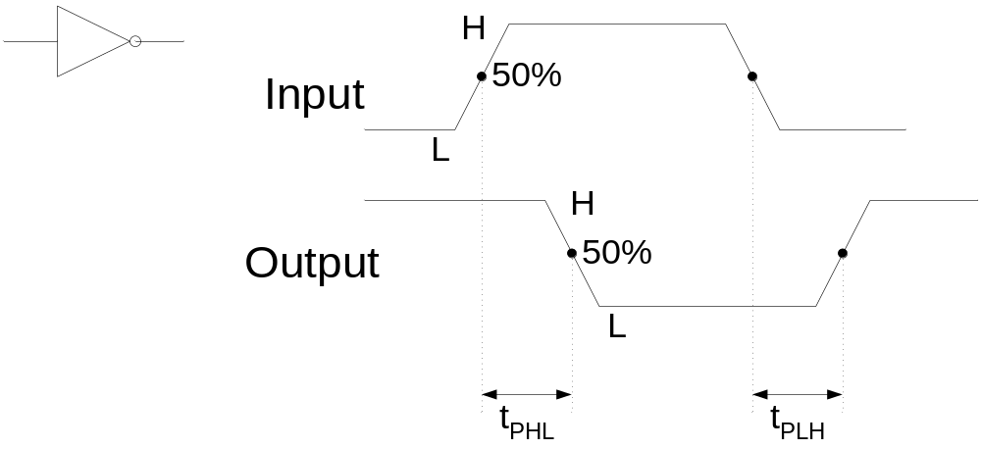
Propagation Delay
t_{PHL} t_{PLH}
Notes:
Propagation Delays for logic gates are specified by t_{PHL} and t_{PLH} parameters
The NOT gate is shown
The output of the NOT gate changes from high to low after a delay of time specified by t_{PHL} after the input changes from low to high.
The output of the NOT gate changes from low to high after a delay of time specified by t_{PLH} after the input changes from high to low
The delay time is measured at the 50% transition mark.

Slide 23
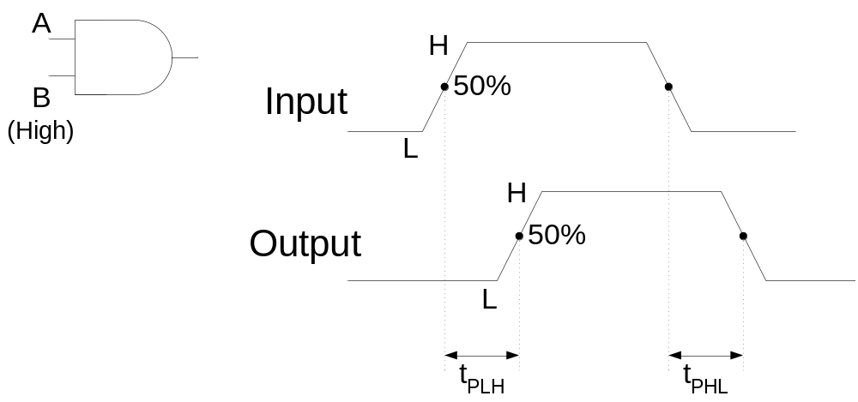
Propagation Delay
Notes:
The AND gate is shown. The input B of the AND gate is permanently connected to H, where as input A varies between H and L.
The output of the AND gate changes from low to high after a delay of time specified by t_{PLH} after the input changes from low to high.
The output of the AND gate changes from high to low after a delay of time specified by t_{PHL} after the input changes from high to low
The delay time is measured at the 50% transition mark.

Slide 24
Speed-Power Product (SPP)
SPP = t_{P} P_{D}
Expressed in Joules (J) units of energy
Lower the SP product better is the performance

Slide 25
Fan-Out
Number of same series gates that a gate can drive.
Fan-Out for TTL circuits is fixed
Fan-Out for CMOS circuits is related to operational frequency.
Fan-Out decreases with increased frequency

Slide 26
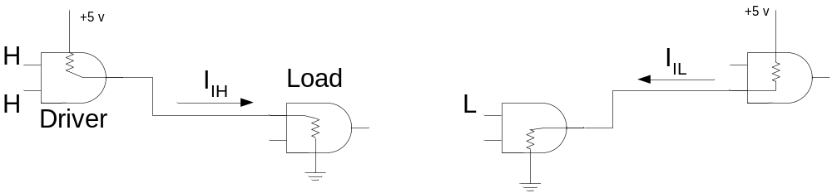
Fan-Out for TTL Loads
Unit Loads = I_{OH}/I_{IH} = I_{OL}/I_{IL}
= 400 μA/40 μA = 16 mA/1.6 mA = 10
Notes:
The fan-out of a logic gate is the maximum number of inputs of the same series in an IC family that can be connected to a gate’s output and still maintain the output voltage levels within the specified limits.
The output current at logic high is I_{OH} = 400 μA
The input current at logic high is I_{IH} = 40 μA
Thus a gate at logic high can source current to another gate connected to its output.
Similarly
The output current at logic low is I_{OL} = 16 mA
The input current at logic low is I_{IL} = 1.6 mA
Thus a gate output at logic low can sink current from another gate connected to its output.
To calculate the unit load that can be connected the Unit load formula is used
Unit Loads = I_{OH}/I_{IH} = I_{OL}/I_{IL} = 400 μA/40 μA = 16 mA/1.6 mA = 10

Slide 27
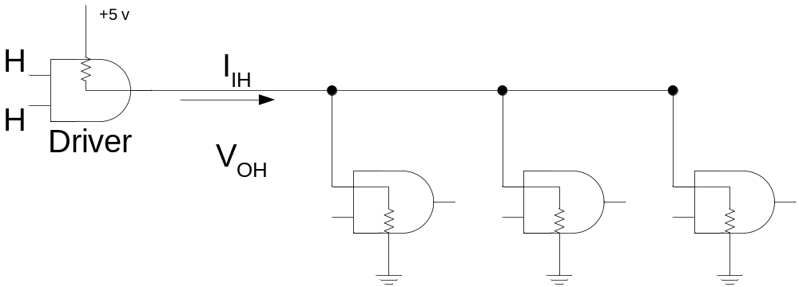
Fan-Out for TTL Loads
Notes:
Considering that
The output current at logic high is I_{OH} = 400 μA
The input current at logic high is I_{IH} = 40 μA
A gate’s output can be connected to inputs of a maximum of 10 gates as 400 μA can be equally distributed amongst 10 gates that is 40 μA each.

Slide 28
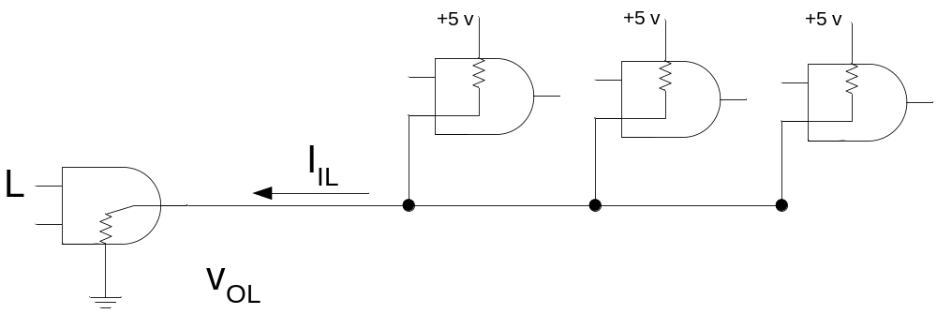
Fan-Out for TTL Loads
Notes:
Similarly considering that
The output current at logic low is I_{OL} = 16 mA
The input current at logic low is I_{IL} = 1.6 mA
A gate’s output can be connected to inputs of a maximum of 10 gates as 1.6 mA from each of the 10 gates can be sunk by it, that is 16 mA
Unit Loads = I_{OH}/I_{IH} = I_{OL}/I_{IL} = 400 μA/40 μA = 16 mA/1.6 mA = 10

Slide 29
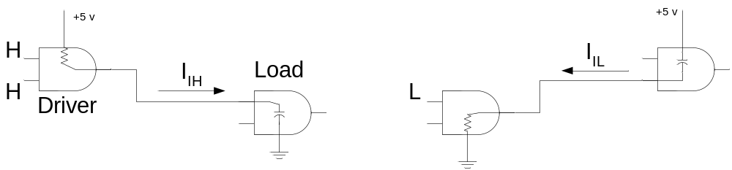
Fan-Out for CMOS Loads
Notes:
CMOS loading is different from TTL loading as the type of transistors used in CMOS circuits presents a capacitive load to the driving gate.
When the output of the driving gate is high the input capacitance of the load gate is charging and when the output of the driver gate is low the load gate is discharging.
When more load gates are added the input capacitance increases as input capacitances are being connected in parallel. With the increase in the capacitance, charging and discharging time increases, reducing the maximum frequency at which the gate can operate.
Therefore the fan-out of a CMOS gate depends upon the maximum frequency of operation. Fewer the load gates greater the maximum frequency of operation.

Slide 30
TTL Series
 | 74 | 74S | 74LS | 74AS | 74ALS | 74F
Performance Rating
Propagation Delay (ns) | 9 | 3 | 9.5 | 1.7 | 4 | 3
Power Dissipation (mW) | 10 | 20 | 2 | 8 | 1.2 | 6
Speed-Power product (pJ) | 90 | 60 | 19 | 13.6 | 4.8 | 18
Max. Clock Rate (MHz) | 35 | 125 | 45 | 200 | 70 | 100
Fan-out (same series) | 10 | 20 | 20 | 40 | 20 | 33

Slide 31
CMOS Series
 | 74HC | 74AC | 74AHC
Propagation Delay (ns) | 18 | 5 | 3.7
Power Dissipation (mW) Static | 0.00275 | 0.0055 | 0.00275
Power Dissipation (mW) at 100KHz | 0.0625 | 0.08 | 0.0625
Speed-Power product (pJ) at 100KHz | 1.125 | 0.4 | 0.23
Max. Clock Rate (MHz) | 50 | 160 | 170
 | 74LV | 74LVC | 74ALVC
Propagation Delay (ns) | 9 | 4.3 | 3
Power Dissipation (mW) Static | 0.0016 | 0.0008 | 0.0008
Max. Clock Rate (MHz) | 90 | 100 | 150

